Slide 1
Azuren OS Guide
t-qichz
Windows Azure®

Slide 2

Agenda
Overview
Design
Issues
Next…
Getting Started with Azuren OS

Slide 3
Overview

Slide 4
Overview
Introduction
OS running in the browser
High Scalability and extensibility
Open Platform && Open Source
Shining effects and animations
Lots of apps in App Store
Online Demo: http://azuren.chinacloudapp.cn/

Slide 5
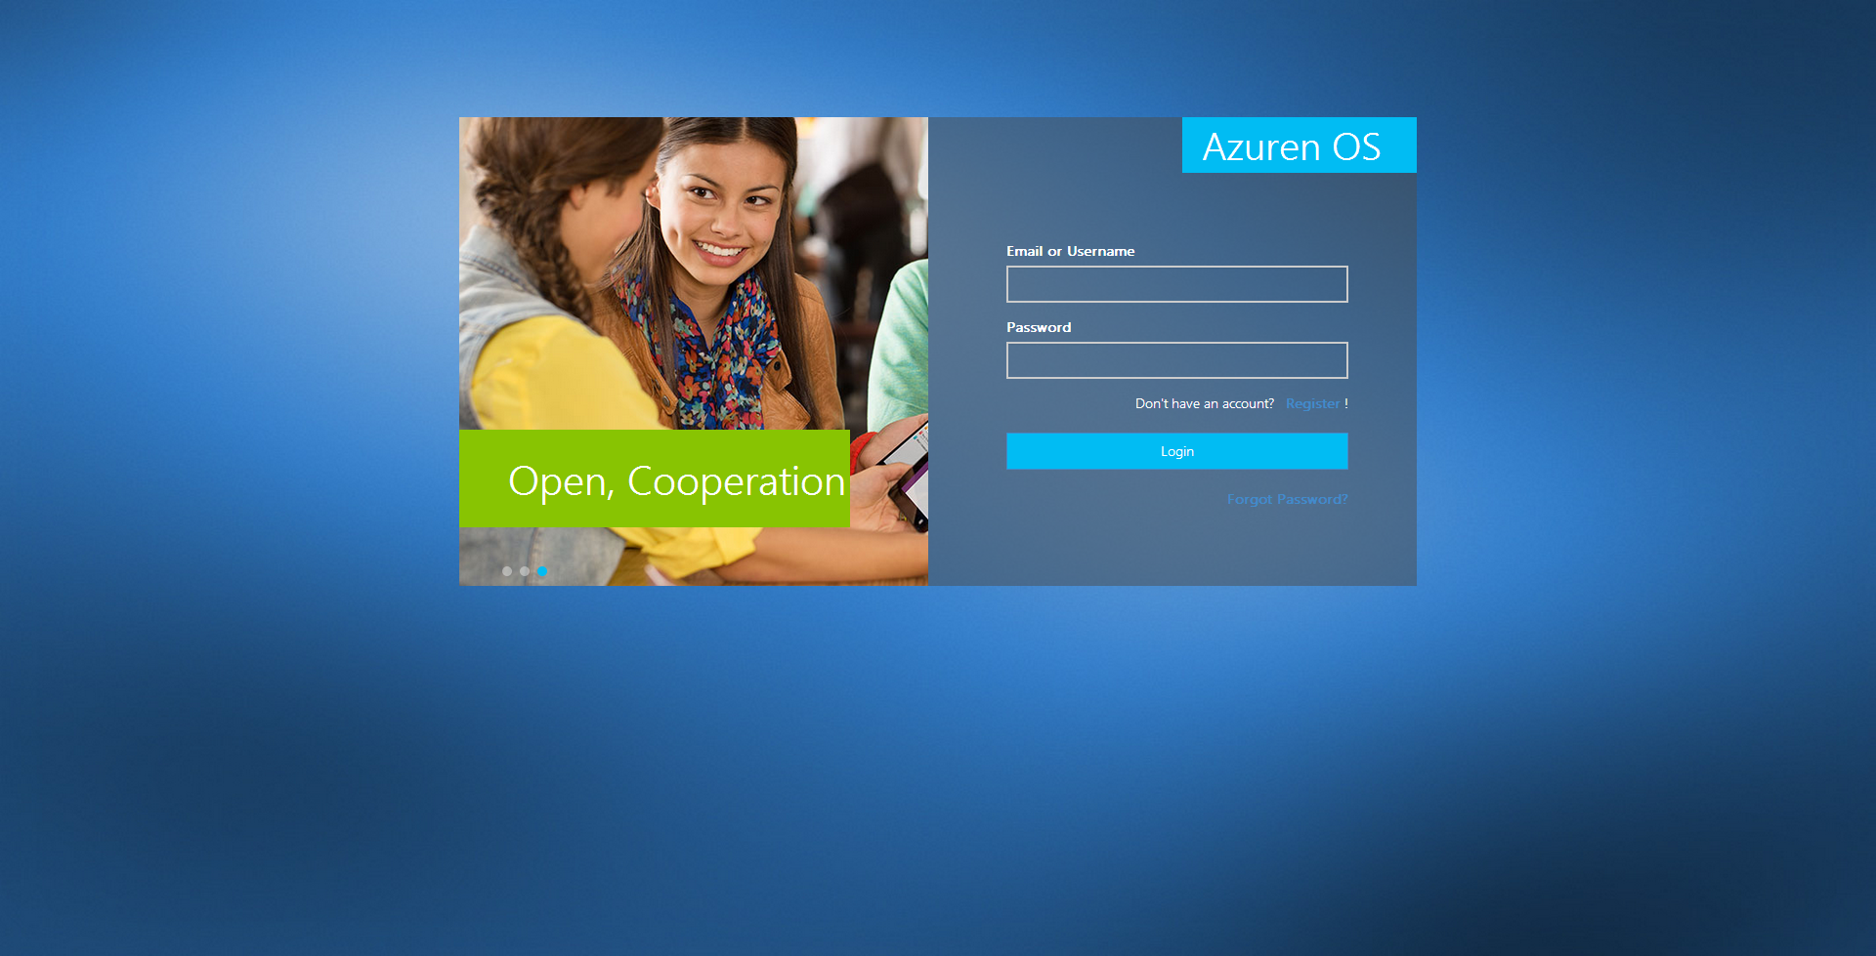
Overview
Login Page

Slide 6
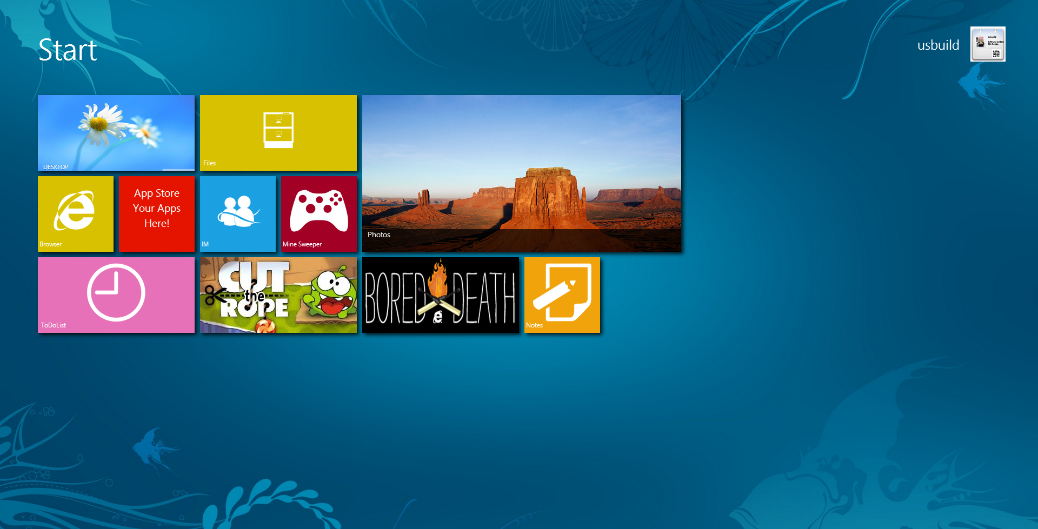
Overview
Start Screen

Slide 7
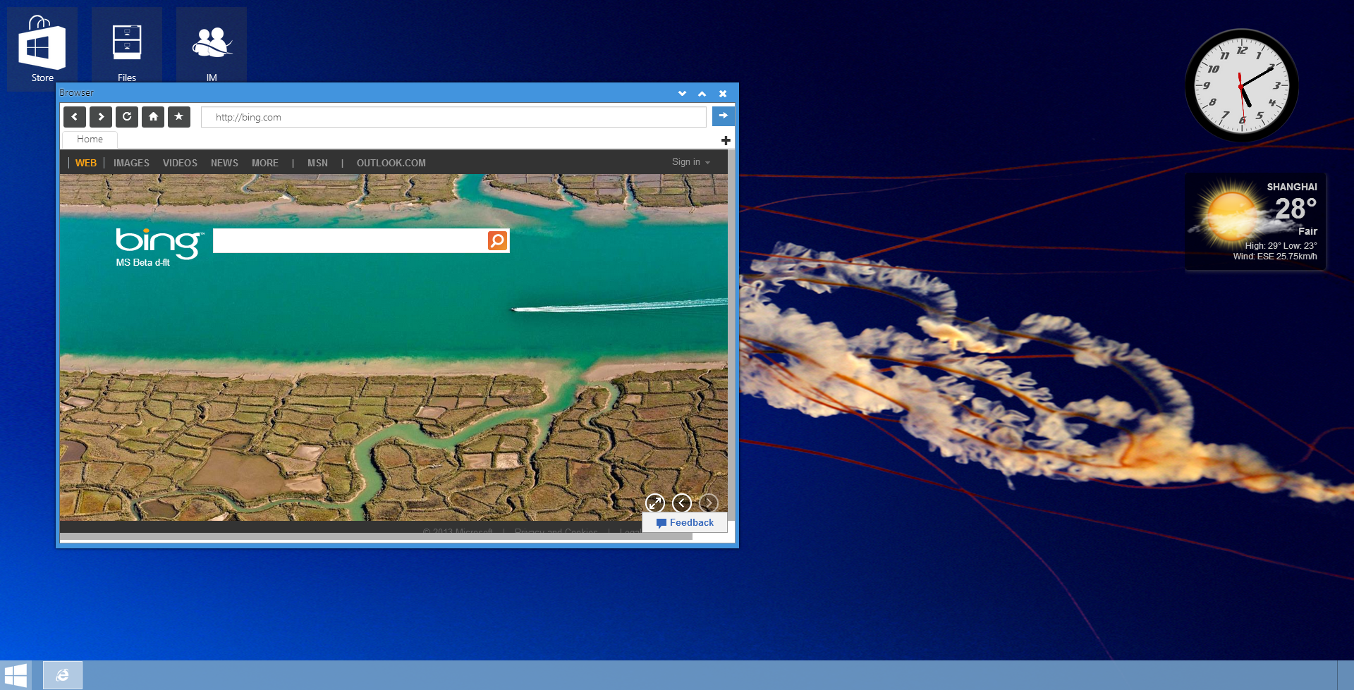
Overview
Desktop

Slide 8
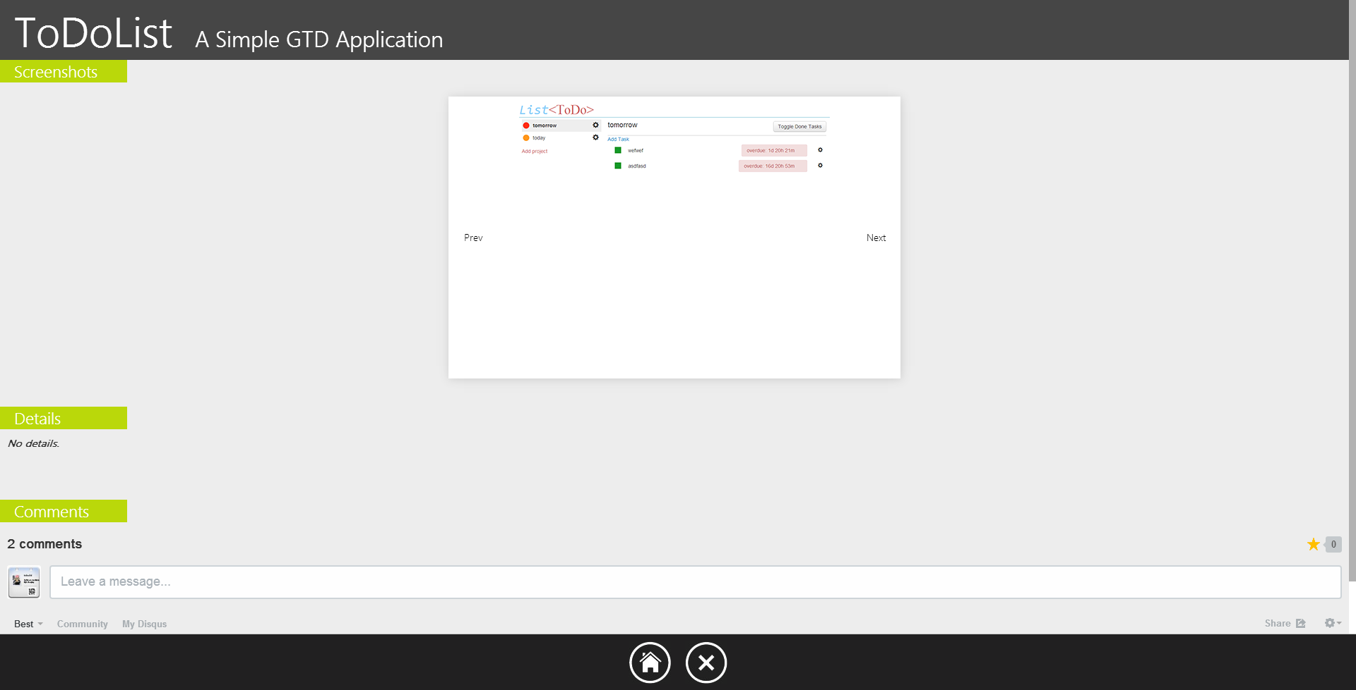
Overview
Apps in App Store

Slide 9
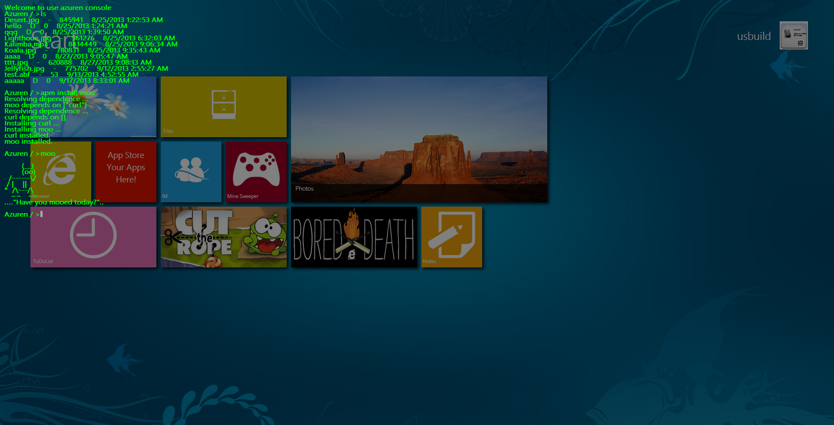
Overview
Shell for advanced users

Slide 10
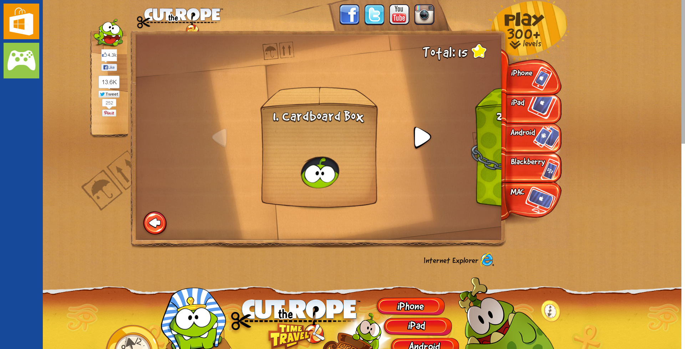
Overview
Games

Slide 11
Overview
40 days of development
10000+ lines of code
4 major versions
25+ external libraries

Slide 12
Overview
Libraries
jQuery
jQuery UI
Bootstrap
fileDownload
jQuery.form
knockout
contextMenu
fancybox
gridster
MetroJs
metroLayout
metroNotification
pnotify
terminal
ueditor
bjqs
signalR
touchSwipe
unslider
DotNetOpenAuth
reCaptcha
modernizr
jsdesktop
Backbone

Slide 13
Design

Slide 14
Design

Slide 15
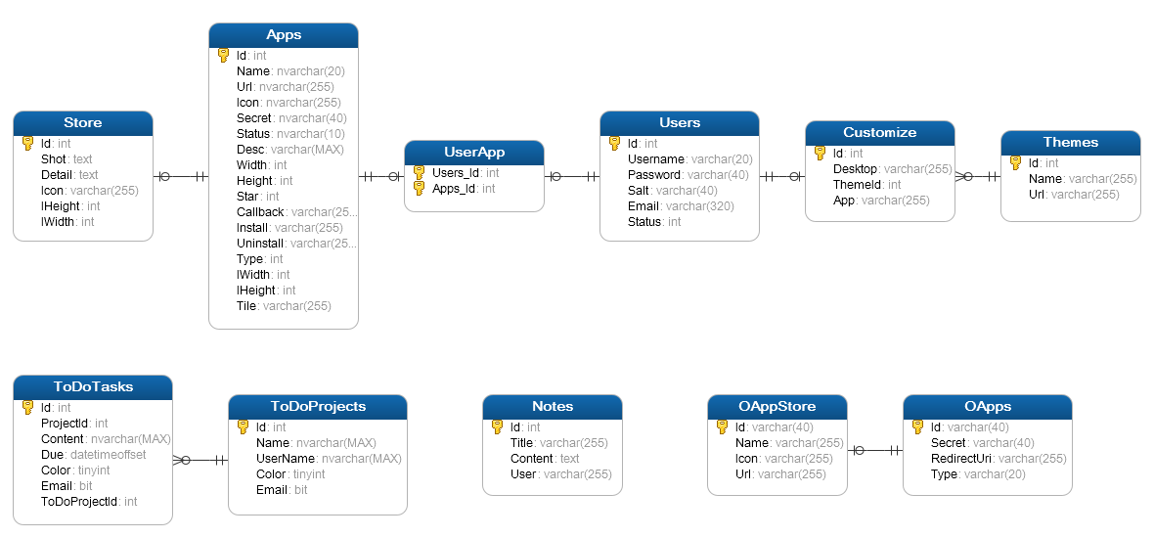
Design

Slide 16




Design
Platform
Built on Windows Azure
Storage : save files and message records, etc
Service Bus: passing messages
SQL Azure: save relations and business logic
Cache: turbo applications’ speed

Slide 17

Design
Windows Manager
Two window managers:
Classic windows manager => traditional window based apps
Taskbar, desktop, widget
Titlebar, control buttons
Metro windows manager => modern styled apps
Metro Taskbar
Application bar
Corner areas
Start menu
Animations
Live Tiles

Slide 18

Design
Inter-application Communication
Front End
Use HTML5 postMessage API
A thin wrapper for this API to support complex interactions: data transfer, callback
Back End
Provide /Service/PostMessage API
Based on service bus
Message can be sent to client instantly

Slide 19
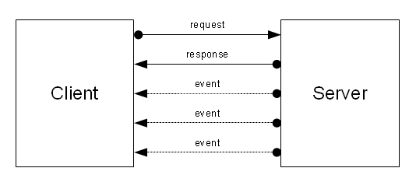
Design
Real-Time Communication
SignalR Library
Comet
WebSocket
Dual channels
ChatHub for realtime chat
AzurenHub for realtime control

Slide 20
Design
Simple Authentication
For in-site apps
One step authentication
Using client redirect to authorize
Can use /Service/* APIs

Slide 21

Design
OAuth2.0
For outer site apps
Use DotNetOpenAuth library
Two step authentication
Can use /api/Service2/* APIs
Life Time
authorization_code 5min
access_token 30 days
refresh_token 365 days
Demo site: http://lecoding.com:8000/oauth/
OS: Ubuntu
Server: UWS
Language: PHP

Slide 22
Design
Shell
Press “`” key to call shell
Provide Azuren.shell namespace APIs
Commands support
Basic file operations: ls, cd, mkdir, touch, download, upload, mv , cp, rm,edit …
App related: app install, app uninstall
Within a JavaScript Interpreter: js
APM Support: apm install, apm source
where there is a shell, there is a way
--Unknown

Slide 23
Design
APM (Azuren Package Manager)
A tool for manage shell apps
package.json for information
main.js for entrance
CAAN(Comprehensive AzurenOS Archive Network) http://lecoding.com:8000/caan/

Slide 24

Design
App Store
Pure Metro
View, comment, install, delete apps
Provide Azure.store namespace api

Slide 25

Design
File
Traditional application
Provide basic file operations
Use storage table to store file structure and information
Use storage blob to store real data
Support view, move, delete, copy, upload, download, edit files
Use HTML5 File API to support Ajax upload
Provide Azuren.file namespace api

Slide 26

Design
Browser
Traditional application
Support multitabs, back, forward, reload etc
Provide Azuren.browser namespace api

Slide 27

Design
IM
Traditional application
Support multi user-group instant talking
This first app of Azuren OS

Slide 28

Design
ToDoList
Traditional application
Support task reminding
Use storage table to simulate priority queue

Slide 29

Design
Note
Metro App
Write with knockoutjs
Development time: less than 2 hours

Slide 30

Design
Games
Metro App
Borrowed from IE experience site
Running in iframes

Slide 31
Issues

Slide 32
Issues
Simulate file system using BLOB
Using additional table to store relations
Redundant information to speed access
A record is like an i-node
Without using Azure supplied Directory:
Inefficient
Can not deal with requirement

Slide 33

Issues
The animations
Using CSS3 instead of jQuery UI Effects
Write a plugin to deal with transition effects
IE10+ support

Slide 34
Issues
ToDoList: How to fetch the most recent event?
The RowKey of Storage table did a lot of work
Acts like a priority queue

Slide 35
Issues
Shell: how to support both client command and server command?
Rewrite jquery-shell source, add pre-filter and post-filter facililty
Filters can be applied during runtime

Slide 36
Issues
OAuth2.0: How to store tokens and codes?
Don’t store it , tokens are self-described
Using symmetrical encryption

Slide 37
Issues
Dealing with cross-domain AJAX
Server proxy
JsonP

Slide 38
Issues
Why using CAAN instead of putting all plugins on Azure?
Enable user to construct their own apm source
Reduce the central server’s pressure
Boost access process

Slide 39
Issues
How manage so many components and apps?
Provide APIs, avoid direct accessing to dom
Using iframes
Separate functions, every js file just does its own job
OO
Implicit invocation: event triggered
Messaging

Slide 40
Next…

Slide 41
Next…
Continue to optimize user experience
Integrate more services
Complete apm and write some development tools
Using some AMD/CMD frameworks: seajs/requirejs
Refactor web page
Shell enhancement

Slide 42



thank you
https://github.com/usbuild
i@lecoding.com
http://lecoding.com

